Slide 1

Unit-II
Relation
Dr. Amit Kumar
Symbiosis Institute of Technology Pune

Slide 2
Some Application of Relation in AIML
Relations are used for creating chatbots and conversational agents for different AIML projects.
A chatbot is an automated program that simulates human conversation through text messages, voice chats, or both.
A conversational agent is a virtual agent one can use to communicate with a human in natural language.
Apple's Siri and Amazon's Alexa are examples of consumer-oriented, data-driven, predictive chatbots.

Slide 3
Dynamic Responses:
Relations can be used to create dynamic responses based on the context of the conversation. The chatbot can adjust its replies based on the relationships between different elements within the dialogue.
Personalization:
By recognizing relations between user preferences, history, and current requests, AIML-based systems can personalize interactions.

Slide 4
Recommendation Systems
It can be applied in recommendation systems where understanding the relationships between users, items, and preferences is essential.
Pattern recognition
Relation play a crucial role in understanding and identifying patterns within data. The relationships between different features or components of a pattern can provide valuable information for classification, detection, and analysis.

Slide 5
Data Mining:
AIML can assist in data mining tasks by recognizing patterns and relationships within large datasets. This can be applied in various domains, such as fraud detection, market analysis, and customer behavior prediction.

Slide 6
Cartesian Product of Sets
Definition: Let A and B be any two non-empty sets. The set of all ordered pairs (a, b) such that a ∈ A and b ∈ B is called the Cartesian product of the sets A and B and is denoted by A × B.
Thus , A × B={(a, b) | a ∈ A and b ∈ B }.
For example: If A={a, b, c} and B={1,2},
then A × B={(a, 1), (a, 2), (b, 1), (b, 2), (c, 1), (c, 2)}
and B × A={(1, a), (1, b), (1, c), (2, a), (2, b), (2, c)}
Remarks:
A × B≠ B × A , unless A= ∅ or B= ∅ (so that A × B= ∅ ) or unless A= B.
If |A|=m and |B|=n, then | A × B |=mn
A × A=A²={(a, a) | a ∈ A and a ∈ A }.

Slide 7
Example
Example: If A={a, b} and B={1, 2, 3} find A × B, B × A, A × A, B × B and (A × B) ∩ (B × A).
Solution : Given A={a, b} and B={1, 2, 3}.
A × B={(a, 1), (a, 2), (a, 3), (b, 1), (b, 2), (b, 3)}
B × A={(1, a), (1, b), (2, a), (2, b), (3, a), (3, b)}
A × A={(a, a), (a, b), (b, a), (b, b)}
B × B={(1, 1), (1, 2), (1, 3), (2, 1), (2, 2), (2, 3), (3,1), (3,2), (3,3)}
Clearly, (A × B) ∩ (B × A)= ∅.

Slide 8











Relation
The relations are define with two entities.
Binary Relation: Let A and B are two sets. Then any subset R of the Cartesian product (A × B) is called relation or binary relation from set A to the set B.
Symbolically it is denoted as :
R ⊆ (A × B)
i.e. R={(a, b) | a ∈ A and b ∈ B }.
Note: (i) If (a, b) ∈ R, we write aRb
(ii) If (a, b) ∉ R, we write aRb
Example.1: Consider A={1,2,3,4,5} and B={5,6,7,8,9}
Let R is the relation from A to B as
R={(x, y) | x ∈ A and y=2x+3 ∈ B }
R={(1, 5), (2, 7), (3, 9)}.

Slide 9
To be Cont…
Example. 2: If A={a, b, c, d}, B={p, q, r, s}, then which of the following of the are relations from A to B? Give reasons for your answer.
R₁={(a, p), (b, r), (c, s)}
R₂={(q, b), (c, s), (d, r)}
R₃={(a, p), (a, q), (d, p), (c, r), (b, r)}
R₄={(a, p), (q, a), (b, s), (s, b)}
Solution: (i) Clear R₁ ⊆ AB, So R₁ is relation from A to B.
(ii) Since (q, b) ∉ AB. So R₂ ⊆ AB.
(iii) Clear R₃ ⊆ AB, So R₃ is relation from A to B.

Slide 10
To be Cont…
(iv) R₄ is not a relation from A to B because ), (q, a), and (s, b) are not in AB . Hence R₄ ⊆ AB
Total Number of Relations:
Let A and B are two finite sets with |A|=m and |B|=n, then the total number of relation from A to B is 2^{mn}, including the empty relation as well as the relation A × B itself.

Slide 11
Domain and Range of Relation:
Let R be a relation from a set A to a set B. Then the set of all first components or coordinates of the ordered pairs belonging to R is called the domain of R, while the set of all second components or coordinates of the ordered pairs in R is called the range R.
Thus Dom(R)= {a | (a, b)∈ R, for a ∈ A }
and Range (R)= {b | (a, b)∈ R, for b ∈ B }
The domain of a relation from A to B is subset of A and its range is a subset of B.
Example.1: If A={1, 3, 5, 7} , B={2, 4, 6, 8, 10} and let
R={(1,8), (3,6), (5,2), (1,4)} be a relation from A to B.
Then, Dom(R)={1, 3, 5} and Range(R)={8, 6, 2, 4}.

Slide 12

To be Cont….
Example.2: Let A={1, 3, 5, 7} and B={2, 4, 6, 8} be two sets and let R be a relation from A to B defined by “(x, y)∈R x > y”. Find the domain and range of relation R from A to B.
Solution : Under relation R, we have
R={(3, 2), (5, 2), (5, 4), (7, 2), (7, 4), (7, 6)}.
⸫ Dom(R)={3, 5, 7}
and Range(R)= {2, 4, 6}.

Slide 13
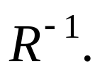
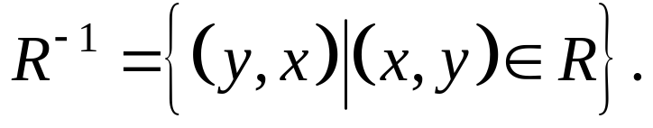
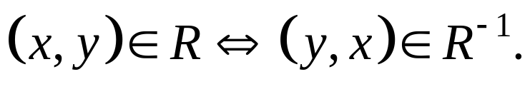
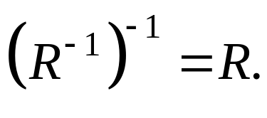
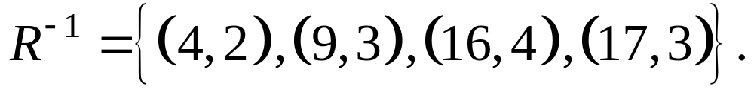
Inverse Relation
Let R is the relation from A to B then the inverse of the relation R is the relation from B to A. It is denoted by
Symbolically ,
Clearly,
Also
Note:
Example: If A={1, 2, 3, 4, 5} , B={4, 9, 16, 17, 25} and R={(2,4), (3,9), (4,16), (3,17)}, then

Slide 14
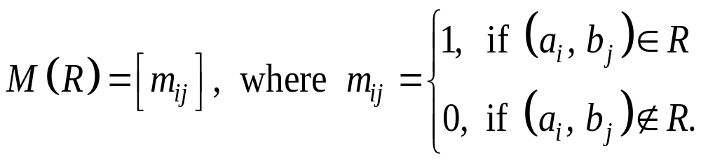
Matrix representation of relations
If R is a relation from A={a₁, a₂, a₃,….,an } to the set B ={b₁, b₂, b₃,….,bn } where the elements of A and B are assumed to be in specific order, the relation R can be represented by the matrix
In other words, the zero-one matrix M(R) has a 1 in its (i-j)th position when aᵢ is related to bⱼ and a 0 in this position when aᵢ is not related by bⱼ.

Slide 15





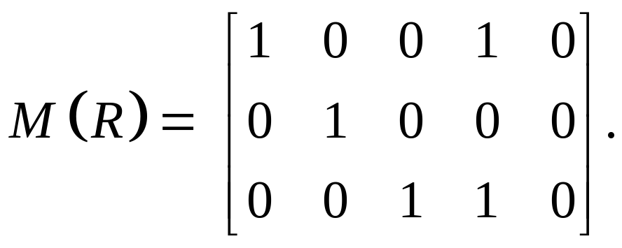



Example
Example.1: If A={1, 2, 3}, B={a, b, c, d, e} and R={(1, a), (1, d), (2, b), (3, c), (3, d)}, then the matrix of R is given by

Slide 16
Representing Relations Using Digraphs
We have shown that a relation can be represented using a zero–one matrix. There is another important way of representing a relation using a pictorial representation. Each element of the set is represented by a point, and each ordered pair is represented using an arc with its direction indicated by an arrow. We use such pictorial representations when we think of relations on a finite set as directed graphs, or digraphs.

Slide 17
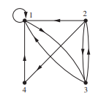
The directed graph of the relation R = {(1, 1), (1, 3), (2, 1), (2, 3), (2, 4), (3, 1), (3, 2), (4, 1)} on the set {1, 2, 3, 4} can be represented as follows.

Slide 18


Composition of relations
Let A, B, C be three sets suppose R is a relation from A to B and S is a relation from B to C. Then composition relation of the two relations R and S is relation from the set A to the set C and is denoted by R•S and is defined as:
R•S={ (a, c) | there exist an element b∈ B such that (a, b)∈ R and (b, c)∈ S, a∈A, c∈ C}
i.e. (a, b)∈ R and (b, c)∈ S (a, c)∈ R•S.
Remark:

Slide 19









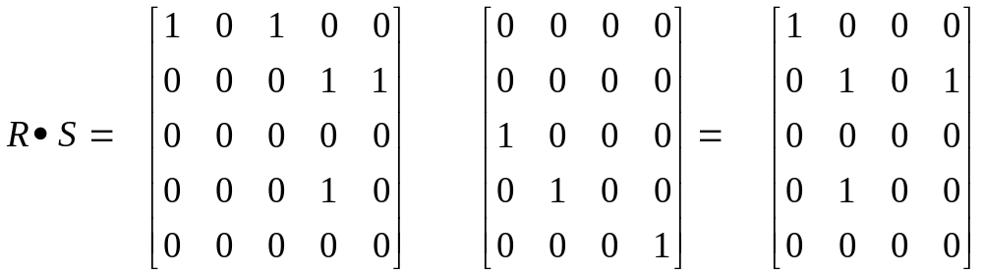



Example
Example .1: Let A={1, 2, 4, 5, 7}, B={a, b, c, d, e}, C={1, 4, 16, 25} and let R={(1, a), (1, c), (2, d), (2, e), (5, d)} and S={(c, 1), (d, 4), (e, 25)}. Compute R•S i. e. what is composite of R and S?
Solution: R•S={(1, 1), (2, 4), (2, 25), (5, 4)}
In term of Matrix representation

Slide 20
Types of Relations
Empty Relation or Void Relation: Let A be a set . Then  ⊆ AA. This relation is called the empty relation on A.
Universal Relation: Let A be a set. Then AA ⊆ AA and so it is a relation on A. This relation is called universal relation on A i.e. R = AA .
Ex: If A={1, 2, 3} and B={a, b}, then the universal relation
Identity Relation: A relation R on a set A is said to be identity relation if every element of A is related to it self only. It is Denoted by Iᴀ.
Mathematically, Iᴀ={(a, a) | a∈ A}
Ex. If A={a, b, c} , then Iᴀ={(a, a), (b, b), (c, c)}.

Slide 21

To be cont….
Reflexive Relation: A relation R on a set A is said to be reflexive relation if every element of A is related to it self.
Example: Let A= {1, 3, 5, 7}, then
R₁ ={ (1,1), (1,3), (1,5), (5,5), (5,7)}
R₂ ={ (1,3), (1,5), (3,5), (5,7)}
R₃ ={ (1,1), (1,3), (1, 7),(3,3), (5,5), (5, 7), (7, 7)}
Only R₃ is reflexive remaining are not.

Slide 22

To be cont….
5. Irreflexive Relation or Anti-reflexive Relation: A relation R defined on a set A is said to be irreflexive or Anti-reflexive if (a, a) ∉ R for every a ∈ A.
Example: Let A= {1, 3, 5, 7}, then
R₁ ={ (1,1), (1,3), (1,5), (5,5), (5,7)}
R₂ ={ (1,3), (1,5), (3,5), (5,7)}
R₃ ={ (1,1), (1,3), (1, 7),(3,3), (5,5), (5, 7), (7, 7)}
Only R₂ is irreflexive remaining are not.

Slide 23
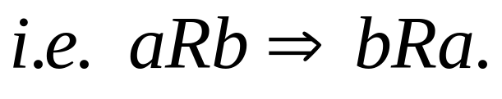
To be cont….
6. Symmetric Relation: A relation R defined on a set A is said to be symmetric, if whenever (a, b)∈ R, then (b, a) ∈ R .
Example: Let A= {1, 3, 5, 7}, then
R₁ ={ (1,1), (1,3), (3,5), (3,1), (5,3), (5,5)}
R₂ = { (1,1), (1,3), (3, 1),(3, 5), (5, 3), (5, 7), (7, 7)}
Only R₁ is symmetric but R₂ is not because (5, 7)∈ R₂ but (7, 5) ∉ R₂.

Slide 24
To be cont….
7. Asymmetric Relation: A relation R defined on a set A is said to be asymmetric, if whenever (a, b)∈ R, then (b, a) ∉ R .
Example: Let A= {1, 3, 5, 7}, then
R₁ ={ (1,3), (3,5), (3,7), (5,7)}
R₂ = { (1,3), (3, 5), (5, 3), (5, 7), (7, 7)}
Only R₁ is asymmetric but R₂ is not because (3, 5)∈ R₂ but (5, 3) ∈ R₂.

Slide 25
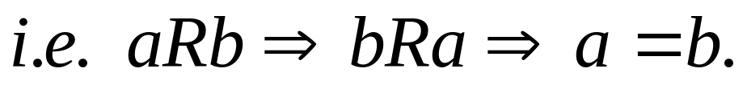

To be cont….
8. Anti-symmetric Relation: A relation R defined on a set A is said to be anti-symmetric, if whenever (a, b)∈ R and (b, a) ∈ R, then a=b .
Example: Let A= {1, 3, 5, 7}, then
R₁ ={ (1,1), (1,3), (3,5), (5,5), (5,7)}
R₂ ={ (1,1), (3,3), (7,7)}
R₃ ={ (3,3), (3,5), (5, 3), (7, 7)}
Only R₁ and R₂ are anti-symmetric but R₃ is not because (3, 5) ∈ R₃, (5, 3) ∈ R₃,

Slide 26
To be cont….
9. Transitive Relation: A relation R defined on a set A is said to be transitive, if whenever (a, b)∈ R and (b, c)∈ R then (a, c)∈ R .
Example: Let A= {1, 3, 5, 7}, then
R₁ ={ (1,1), (1,3), (1,5), (1,7), (3,3) (3,5), (3,7), (5,3), (5,5), (5,7)}
R₂ ={ (1,1), (1,3), (3,5), (5,5), (7,7)}
Only R₁ is transitive but R₂ is not because (1, 3)∈ R₂ , (3,5) ∈ R₂ , (1,5) ∉ R₂.

Slide 27
To be cont….
10. Equivalence Relation: A relation R defined on a set A is said to be equivalence relation in A , if R is reflexive, symmetric and transitive.
Example: Let A= {0, 1, 2, 3}, then
R₁ ={ (0, 0), (1, 1), (1,2), (2, 1), (2,2), (3,3)}
R₂ ={ (0, 0), (1, 1), (1, 3), (2, 2), (2, 3), (3,1), (3, 2), (3, 3)}
Here, R₁ is reflexive, symmetric and transitive
Therefore R₁ is equivalence relation.
R₂ is reflexive, symmetric and but not transitive, since (1,3) and (3,2) ∈ R₂ but (1,2) ∉ R₂.
Therefore R₂ is not equivalence relation.

Slide 28
To be cont….
11. Partial Order Relation: A relation R defined on a set A is said to be partial order relation in A, if R is reflexive, anti-symmetric and transitive.
Example: Let A= {1, 3, 5, 7}, then
R₁ ={ (1,1), (1,3), (3,3) , (3,5), (5,5), (7,7)}
R₂ ={(1,1), (3,3), (3,5), ,(5,5), (7, 7)}
Here, R₁ is reflexive, anti-symmetric and but not transitive
Therefore R₁ is not partial order relation.
R₂ is reflexive, anti-symmetric and transitive.
Therefore R₂ is partial order relation.

Slide 29
Example
Consider the set of natural numbers N. Consider the relation R given by the following:
aRb if a divides b.
For example, 5R10 because 5 divides 10.
5 is not related to 11 because 5 does not divide 11.
Check if R described above is a Partial Order Relation.

Slide 30
Think on the following.
Q. Which of the following, on the set of all peoples are equivalence relation.
{(a,b): a and b are of the same age}
{(a,b): a and b are of the same parents}
{(a,b): a and b share a common parent}
{(a,b): a is of b}
{(a,b): a and b is having same gender}

Slide 31


Slide 32
POSET
A relation R on a set S is called a partial ordering or partial ordered relation if R is reflexive, antisymmetric, and transitive.
A set S together with a partial ordering R is called a partially ordered set, or Poset, and is denoted by (S, R).
Members of S are called elements of the Poset.

Slide 33
Some Examples of POSET
The set of Natural numbers with ≤ (less than or equal to).
The set of Positive integers with relation divisibility.
The power set with subset relation.

Slide 34
Q. Let R be the relation on the set of people such that xRy if x and y are people and x is older than y. Show that R is not a partial ordering.

Slide 35
Sol: Note that R is antisymmetric because if a person x is older than a person y, then y is not older than x. That is, if xRy, then y R x. The relation R is transitive because if person x is older than person y and y is older than person z, then x is older than z. That is, if xRy and yRz, then xRz. However, R is not reflexive, because no person is older than himself or herself. That is, x R x for all people x. It follows that R is not a partial ordering

Slide 36
Hasse Diagrams
A graphical representation of a POSET is know as Hasse diagram.
Working steps to draw a Hasse diagram

Slide 37
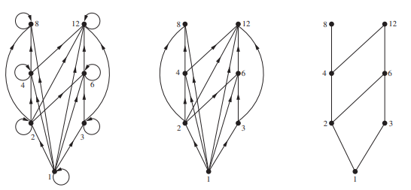
Draw the Hasse diagram representing the partial ordering {(a, b)|a divides b} on {1, 2, 3, 4, 6, 8, 12}.

Slide 38
Procedure :
Start with the directed graph for the given relation. That is, represent all the elements of the set as vertices of the graph, and join all the related elements by corresponding edges.
Since the given relation is reflexive, all elements (vertices) are related to each other. We can remove all the loops (edges joining a vertex to itself).
Since the relation is also transitive, we can remove all the edges that are present because of this transitivity. That is, if aRb and bRc, then the edge joining a and c can be removed.
Finally, arrange the edges and vertices in such a way that the initial vertex is below its corresponding terminal vertex. For example, if aRb, then the vertex representing a should lie below the vertex representing b, and the edge joining the two should be in the “upward direction”.

Slide 39
Draw the Hasse diagram for the “less than or equal to” relation on {0, 2, 5, 10, 11, 15}.
Draw the Hasse diagram for the relation of subset on the power set of S, where S = {a, b, c}.

Slide 40
Points to be remember
Let A be a set and R be a relation defined on A such that (A, R) is a POSET. Than
Maximal element: An element a ∈ A is called maximal if there is no other element b ∈ A such that a R b. That is, an element a is maximal if it has no immediate successor of a.
Minimal element: An element a ∈ A is called minimal if there is no other element b ∈ A such that b R a. In other words, an element a is minimal if it has no immediate predecessor.

Slide 41
Comparable Elements:
Two elements a and b of set A are called comparable if
a R b or b R a
Non-Comparable Elements:
Two elements a and b of set A are called non-comparable
if neither a R b nor b R a.

Slide 42
Cont.…
Least element: An element a∈A is called the least (minimum) element if it predecessor of every other element of the poset i.e. a is related to all other element of the set A.
aRb, for every b in A
Greatest element: An element a∈A is called the greatest (maximum) element if it successor of every other element of the poset i.e. related to all other element of the set A.
bRa, for every a in A
Note: Least and Greatest element of a poset is Unique, if exist.

Slide 43


Cont.…
Upper bound: An upper bound of a subset S of A in a poset (A, R) is an element u in A such that,
Lower bound: A lower bound of a subset S of A in a poset (A, R) is an element u in A such that,

Slide 44
Note :
An element is said to be upper/lower bound of element a and b if it is successor/ predecessor of a and b.
Every element is upper as well as lower bound of it self.
It's important to note that upper and lower bounds are not necessarily unique. A poset may have multiple upper bounds or lower bounds for a given subset.

Slide 45

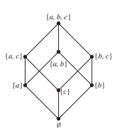

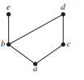
Think on the following.
Find the Maximal, Minimal, Greatest, least element of the following Hasses diagram.

Slide 46
Least Upper Bound (LUB):
The least element out of all the upper bound of a set is called Least Upper Bound of the set. It is also known as supremum of the set.
Greatest lower Bound (GLB):
The greatest element out of all the lower bound of a set is called Greatest lower Bound of the set. It is also known as infimum of the set.

Slide 47
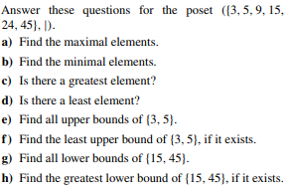
1. Find the greatest lower bound and the least upper bound of the sets{3, 9, 12} and {1, 2, 4, 5, 10}, if they exist, in the poset (Z+, |).
2.

Slide 48
Solution
The lower bound of {3, 9, 12}={1,3}
3 is the GLB or infimum of {3, 9, 12}.
The lower of {1, 2, 4, 5, 10}={1}
1 is the is the GLB or infimum {1, 2, 4, 5, 10}.
The Least upper bound or supremum of {3, 9, 12}=36
The Least upper bound or supremum of {1, 2, 4, 5, 10}=20

Slide 49
Lattice
A partially ordered set in which every pair of elements has both a least upper bound and a greatest lower bound is called a lattice.
A lattice is a partially ordered set (L, R) in which every subset {a, b} of L has a least upper bound and a greatest lower bound.

Slide 50
Determine whether these posets are lattices.
a) ({1, 3, 6, 9, 12}, |)
b) ({1, 5, 25, 125}, |)
c) (Z, ≥)

Slide 51
Thank you!

